Slide 1
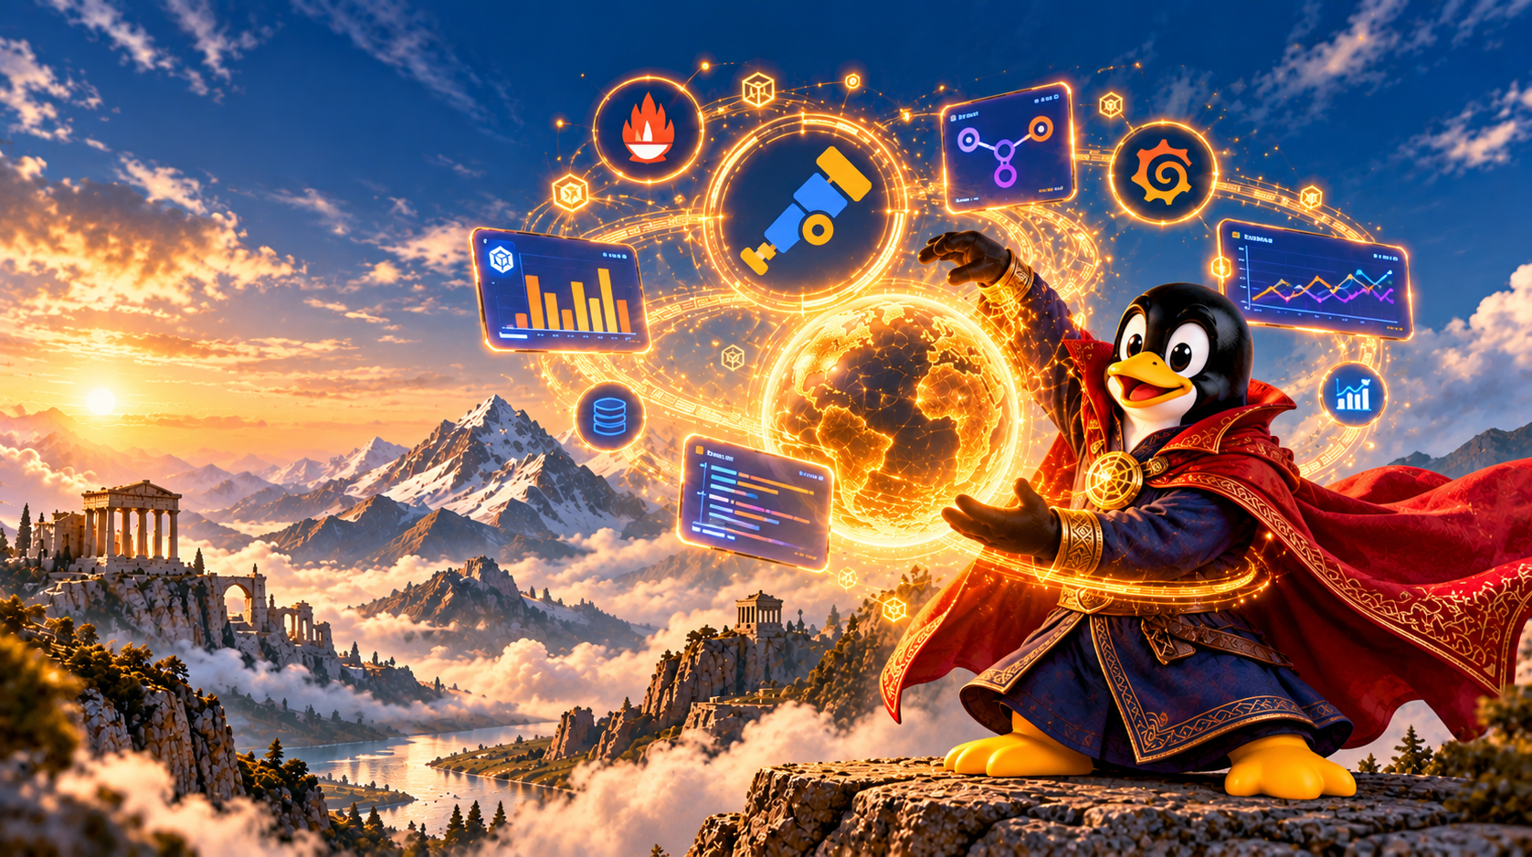
Open Telemetry
From Incidents
to Insight
Farshad Nickfetrat
Notes:
Suggested pacing: about 30 minutes of teaching plus a 10-minute live demonstration. By the end, students should distinguish scheduling, delivery pipelines, provisioning, and infrastructure as code.

Slide 2


Who am I ?
Farshad Nickfetrat
CTO of Devops Iran
Founder of Packops.ir
Devops Team Lead At ADLAS
Devops Engineer Alibaba
Devops Engineer Zarinpal
Notes:
Merged supporting material:
GitLab: 31 January 2017
What happened?
GitLab experienced PostgreSQL database replication problems.
An engineer attempted to fix the issue by removing data from a secondary database.
By mistake, the engineer executed rm -rf on the primary production database.
Approximately 300 GB of production data was deleted.
Backup systems failed to provide a recent, reliable recovery point.
Impact
18 hours of service disruption
Approximately 6 hours of data permanently lost
Around 5,000 projects and 5,000 comments affected
Root causes
Human error during manual operations
Insufficient safeguards against destructive commands
Unreliable and untested backup procedures
Lack of automated recovery validation
Key lesson for automation:
One wrong command caused the incident, but missing safeguards and unreliable backups turned it into a disaster.
Official report: GitLab Incident Postmortem

Slide 3
Cloudflare incident
The Day Internet Broked
Notes:
Close the loop with the opening stories: verify deployment consistency, monitor jobs, test recovery, and review infrastructure changes. Ask students: which guardrail would have caught each failure, and where would you enforce it in the ArvanCloud workflow?

Slide 4
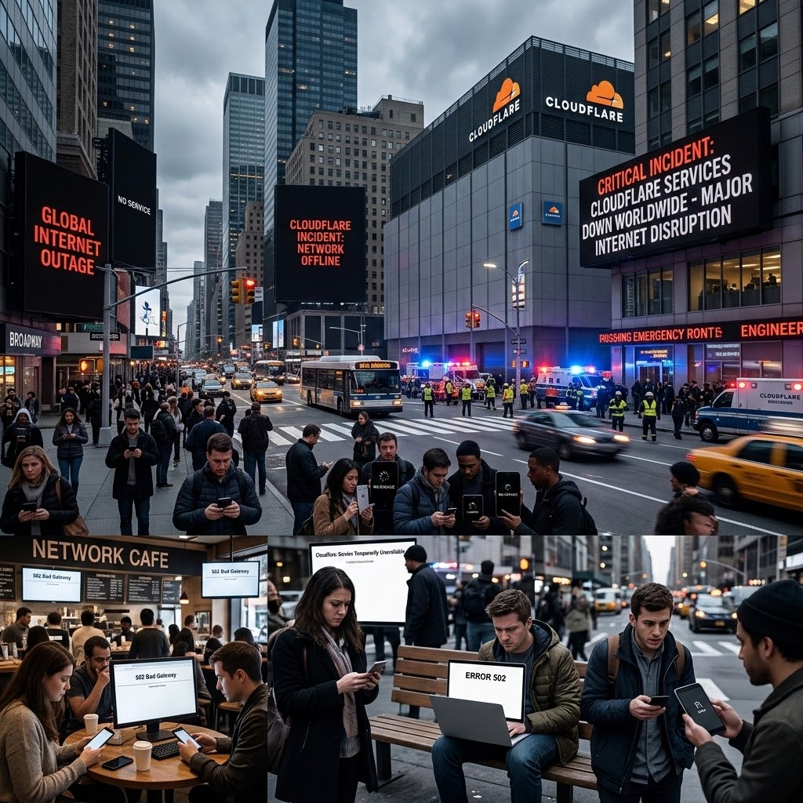
Cloudflare incident
An outage becomes a detective story.
What changed, which services failed, and how did errors spread?
It tooks 6 Hours to understand !!

Slide 5
Cloudflare incident: an investigation
Investigation framework
Metrics tell us when and how much.
Logs explain individual failures.
Traces show the request path.
These are suggested investigation steps, not claims about Cloudflare’s actual instrumentation.
What happened?
Start with the official incident timeline.
Compare error-rate and latency changes.
Inspect component logs and deployment events.
Trace a failing request where instrumentation exists.
Observability does not prevent every outage.

Slide 6
You can’t fix what you Don't understand
Notes:
Close the loop with the opening stories: verify deployment consistency, monitor jobs, test recovery, and review infrastructure changes. Ask students: which guardrail would have caught each failure, and where would you enforce it in the ArvanCloud workflow?

Slide 7
Monitoring VS Observability
Monitoring tell you something is broken
observability tells you why

Slide 8
When we need Observility
Before an incident
During Incident
After incident
Prediction/prevention
Analysis
& Improvement
Diagnos / Tshoot

Slide 9
Doesn't mean knowing why it’s broken
Knowing Something is broken
Notes:
Close the loop with the opening stories: verify deployment consistency, monitor jobs, test recovery, and review infrastructure changes. Ask students: which guardrail would have caught each failure, and where would you enforce it in the ArvanCloud workflow?

Slide 10
Not system alerts
Observability is about system behaviour
Notes:
Close the loop with the opening stories: verify deployment consistency, monitor jobs, test recovery, and review infrastructure changes. Ask students: which guardrail would have caught each failure, and where would you enforce it in the ArvanCloud workflow?

Slide 11
Evidence shortens the path from symptom to root cause.
THE LESSON
Notes:
Ask students what failed in each story. Knight combined a manual deployment gap with rapid automated execution. GitLab combined a destructive manual action with broken backup automation. The common problem was missing controls around operations. Avoid claiming that automation alone guarantees safety.

Slide 12
Evidence shortens the path from symptom to root cause.
THE LESSON
Notes:
Ask students what failed in each story. Knight combined a manual deployment gap with rapid automated execution. GitLab combined a destructive manual action with broken backup automation. The common problem was missing controls around operations. Avoid claiming that automation alone guarantees safety.

Slide 13



3 pillars of observability
show_chart
receipt_long
alt_route
METRICS
Time series reveal rates and trends.
LOGS
Events explain what happened.
TRACES
Spans reveal latency across services.
Notes:
Open with the story before introducing the topic. A technician missed one of eight servers during deployment. Legacy code responded to the new flag. The trading system rapidly built unwanted positions. The SEC reports a $460 million realized loss, while early reporting often used $440 million. Lesson: use verified deployment automation with risk limits. These are proposed controls, not proof that any one tool would have prevented the incident.
Source: https://www.sec.gov/litigation/admin/2013/34-70694.pdf

Slide 14
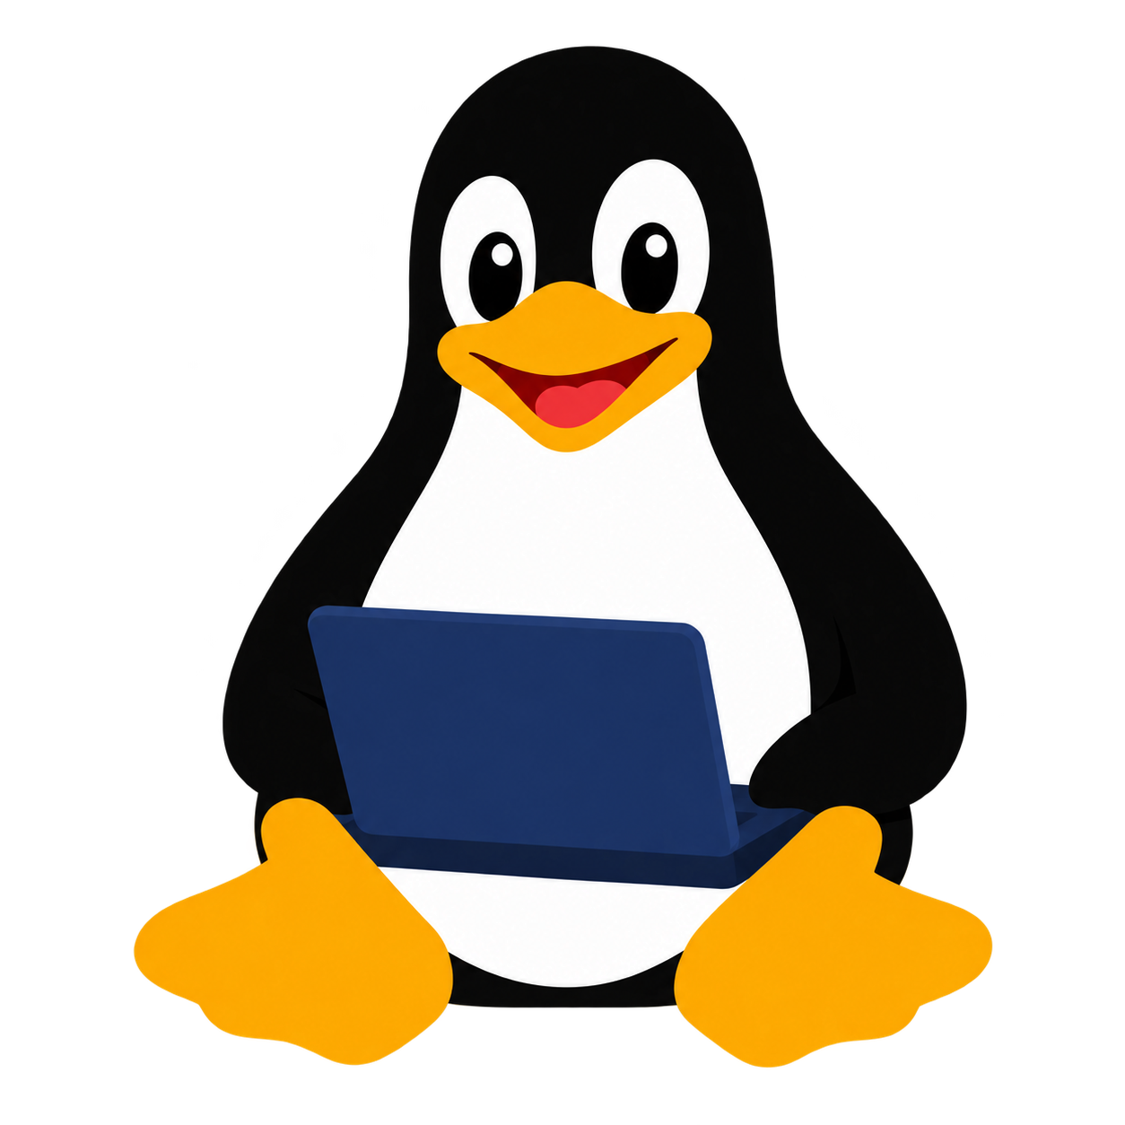



Monitoring (Metrics)
Monitoring is like a nurse!
Just as a nurse regularly checks a patient's vital signs, monitoring continuously inspects the health of the infrastructure, services, and individual system components.
Continuous Health Checks: Real-time assessment and measurement of the operating status of all infrastructure components.
Metrics Collection: Recording and measuring key performance indicators such as CPU usage, RAM memory, and network traffic.
Early Alerting: Rapid detection of anomalies and issues before service outages occur.
Notes:
Steam-powered machinery helped reshape industrial production. Later factory control systems added feedback and automated sequencing. Software extended this idea to digital operations. This is a conceptual history, not a claim that each phase replaced the previous one.
Source: https://blog.sciencemuseum.org.uk/steaming-through-the-centuries/

Slide 15
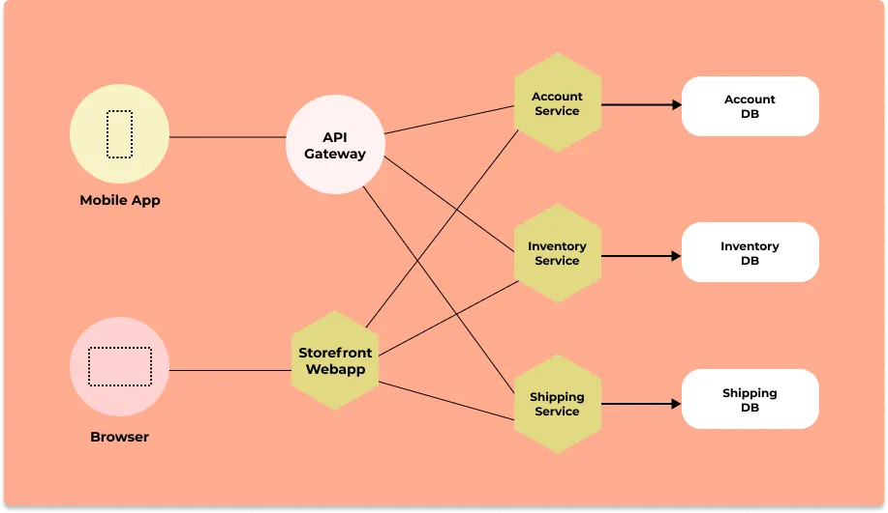
Tracing
A trace is a detailed representation of a request’s journey as it travels various services within a distributed system. It acts like a map, illustrating how the request moves through different components. A trace consists of multiple spans, each representing a discrete unit of work within a service (e.g., a network request or database query). These spans collectively form the entire path of the request through the system.
Notes:
Steam-powered machinery helped reshape industrial production. Later factory control systems added feedback and automated sequencing. Software extended this idea to digital operations. This is a conceptual history, not a claim that each phase replaced the previous one.
Source: https://blog.sciencemuseum.org.uk/steaming-through-the-centuries/

Slide 16
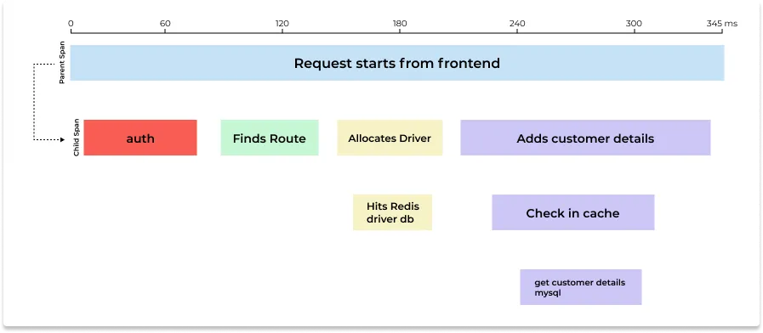
Span
What are spans in distributed tracing?
In distributed tracing, a user request or a transaction is represented by a trace. Traces are broken down into multiple spans. Spans represent a single logical operation within a trace. For example, a function call during a user request can be represented by a span.
Notes:
Steam-powered machinery helped reshape industrial production. Later factory control systems added feedback and automated sequencing. Software extended this idea to digital operations. This is a conceptual history, not a claim that each phase replaced the previous one.
Source: https://blog.sciencemuseum.org.uk/steaming-through-the-centuries/

Slide 17
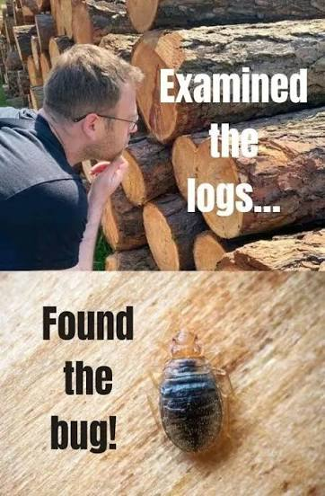
Log
A log is an immutable, time-stamped record of discrete events happening within a system.
Why Logs Matter in Telemetry
1. Root Cause Analysis
2. Audit & Compliance
Provides detailed contextual evidence (stack traces, exact error payloads) when a failure occurs.
Serves as an authoritative history of user activities, security checks, and state transitions over time.
3. High Granularity
4. Debugging Unforeseen Issues
Captures exact variable states and specific logic paths that aggregates (metrics) obscure.
Allows developers to inspect arbitrary event details without re-instrumenting code in advance.

Slide 18
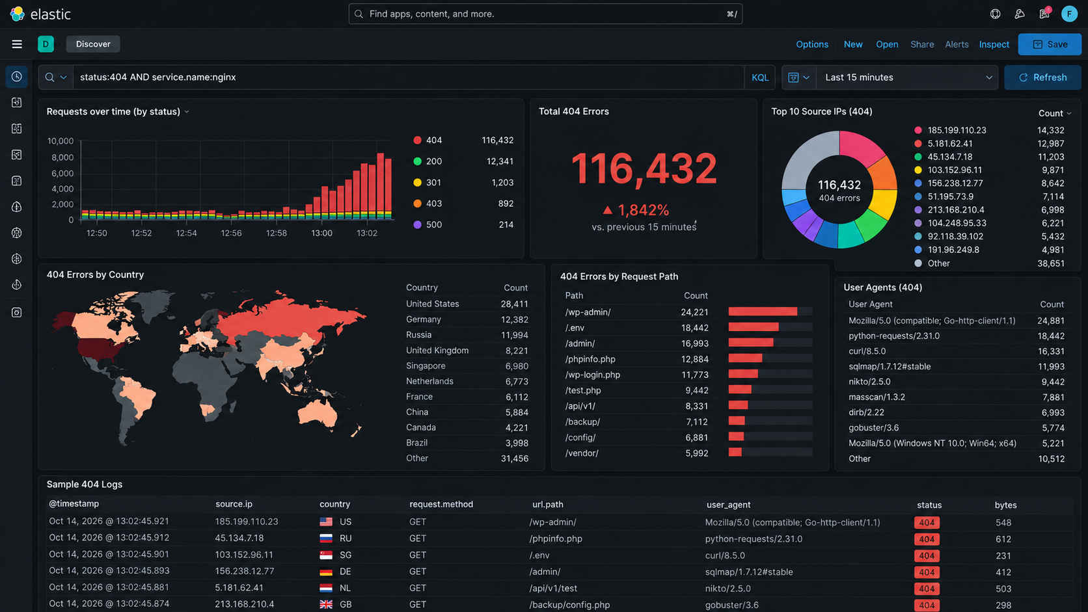
Who , when , what action ?

Slide 19
eBPF: Zero-Code Observability
Extended Berkeley Packet Filter (eBPF) allows running sandboxed programs in the Linux kernel without changing kernel source code or loading modules, powering seamless telemetry for OpenTelemetry.
Key Benefits
OpenTelemetry Use Cases
⚡ Zero Code Modification
Instantly trace applications without rebuilding or re-deploying code.
🚀 Ultra-Low Overhead
Executes directly in kernel space with minimal CPU/memory footprint.
🔒 Deep System Safety
Verified by the kernel to ensure zero risk of crashing production servers.
🌐 Auto-Instrumentation
Capture HTTP, gRPC, and database calls automatically across services.
📡 Network & Security Metrics
Track TCP connections, packet loss, latency, and socket events effortlessly.
🐧 Legacy & Multi-Lang Coverage
Monitor polyglot apps and legacy binaries that lack native SDKs.

Slide 20
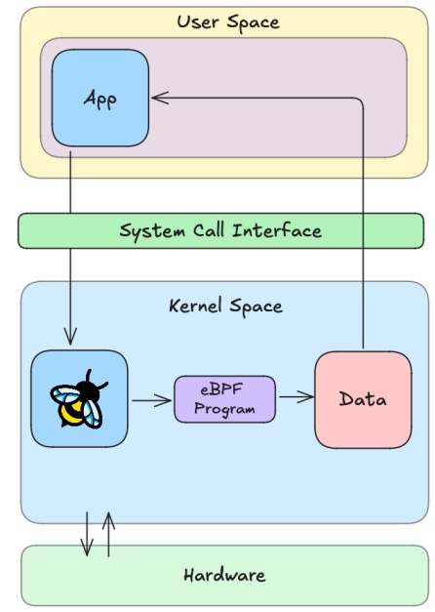
eBPF: Zero-Code Observability

Slide 21
eBPF: Zero-Code Observability
By executing sandboxed bytecode directly inside the Linux Kernel, eBPF captures events at the system level without modifying application source code.
Key Benefits of Direct Kernel Access
⚡ Zero Code & Zero Restart Instrumentation
No app modifications, SDK imports, or service restarts required. Captures traffic system-wide instantly across all languages.
🚀 Native Engine Speed & Low Overhead
Runs as native machine code inside kernel space. Avoids costly user-to-kernel context switches and packet copying overhead.
🛡️ Total Observability & System Safety
Inspects system calls, network sockets, and container boundaries with 100% visibility. Strictly verifier-checked to guarantee non-crashing execution.

Slide 22
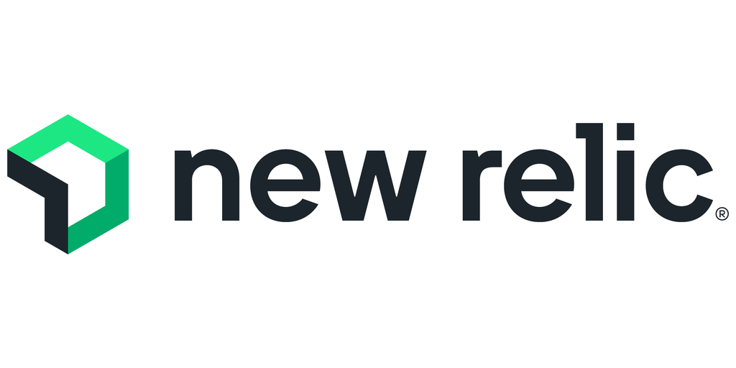
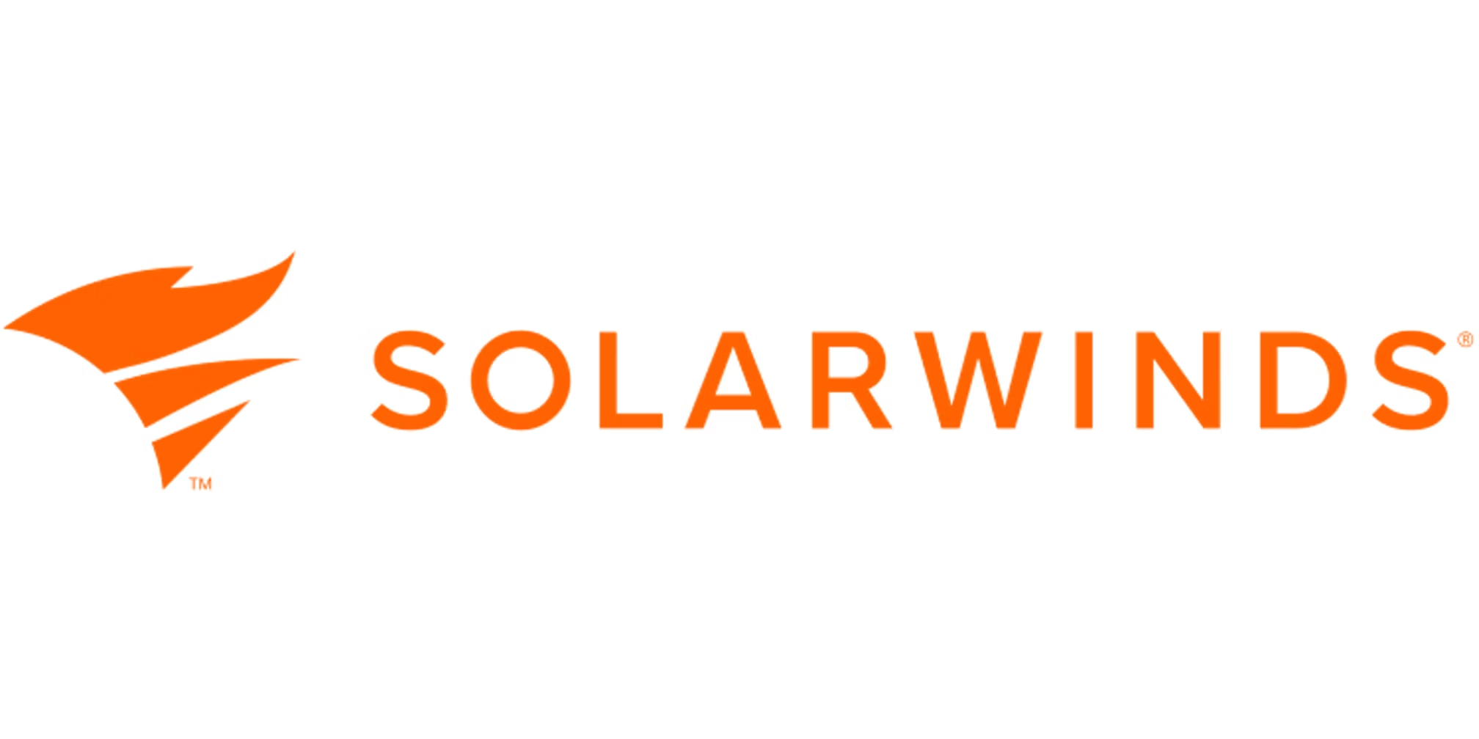

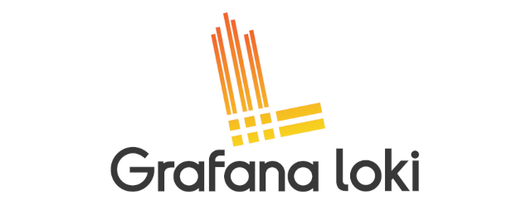
What if ?
What if we want to move from these technologies to another

Slide 23

What is Open Telemetry?
Open Telemetry is an open source observability framework for collecting telemetry data.
Why Open Telemetry?
Key idea
Vendor-neutral
Language-agnostic
Standardized approach
Instrument once, export anywhere
Jaeger, Prometheus, Grafana
Datadog, New Relic
Notes:
Source: https://www.youtube.com/watch?v=D4qJ-QJO-WE
Adapted from the video slide at approximately 4:25–5:11. Content fitted to the presentation theme.

Slide 24
What Open Telemetry Does
What Does
Collect
Ship
What Does not Do
Store
Query
Alert
Dashboard

Slide 25
Instrumentation makes applications observable
Instrumentation enables an application to generate telemetry about its behavior and performance.
The Sensor Analogy
How it Works
Acts like sensors built into a vehicle
Monitors speed, temperature & health
Provides continuous diagnostic data
Embeds measurement hooks in code
Generates metrics, traces, and logs
Exposes internal state without stopping
Notes:
Source: https://www.youtube.com/watch?v=D4qJ-QJO-WE
Adapted from 1:46–3:10. Content fitted to the presentation framework.

Slide 26
Auto-Instrumentation: Real-World Metrics
Zero-code agents extract HTTP, runtime, and DB signals out of the box.
HTTP & Web Frameworks
Runtime & JVM / Process
Database & Clients
Request counts & rates
HTTP status code breakdown
Latency & duration distribution
Example Metric:
http.server.duration
CPU & Memory usage
Garbage Collection pause times
Active thread pool count
Example Metric:
process.runtime.jvm.memory.usage
SQL query execution time
DB connection pool saturation
Outbound RPC / HTTP client calls
Example Metric:
db.client.connections.usage

Slide 27
Zero-code instrumentation
An agent adds observability at application startup without changing the source code.
How it works
Strengths and limits
Attaches at runtime
Intercepts supported libraries
Generates telemetry automatically
Fast setup and broad coverage
Useful for legacy applications
Limited business context
Notes:
Source: https://www.youtube.com/watch?v=D4qJ-QJO-WE
Adapted from 10:13–20:25. Content fitted to the presentation framework.

Slide 28
Code and zero-code work together
The strongest coverage combines fast automatic visibility with manual business context.
Zero-code baseline
Manual enrichment
Framework and library coverage
Minimal setup effort
Standard technical signals
Critical business workflows
Rich attributes and events
Precise control where it matters
Notes:
Source: https://www.youtube.com/watch?v=D4qJ-QJO-WE
Adapted from 18:54–21:59. Content fitted to the presentation framework.

Slide 29
Instrumentation challenges
More telemetry does not automatically produce better observability.
Common challenges
Practical responses
Too much noisy data
Performance overhead
Missing business context
Focus on critical journeys
Use sampling
Add meaningful identifiers
Notes:
Source: https://www.youtube.com/watch?v=D4qJ-QJO-WE
Adapted from 29:44–30:42. Content fitted to the presentation framework.

Slide 30
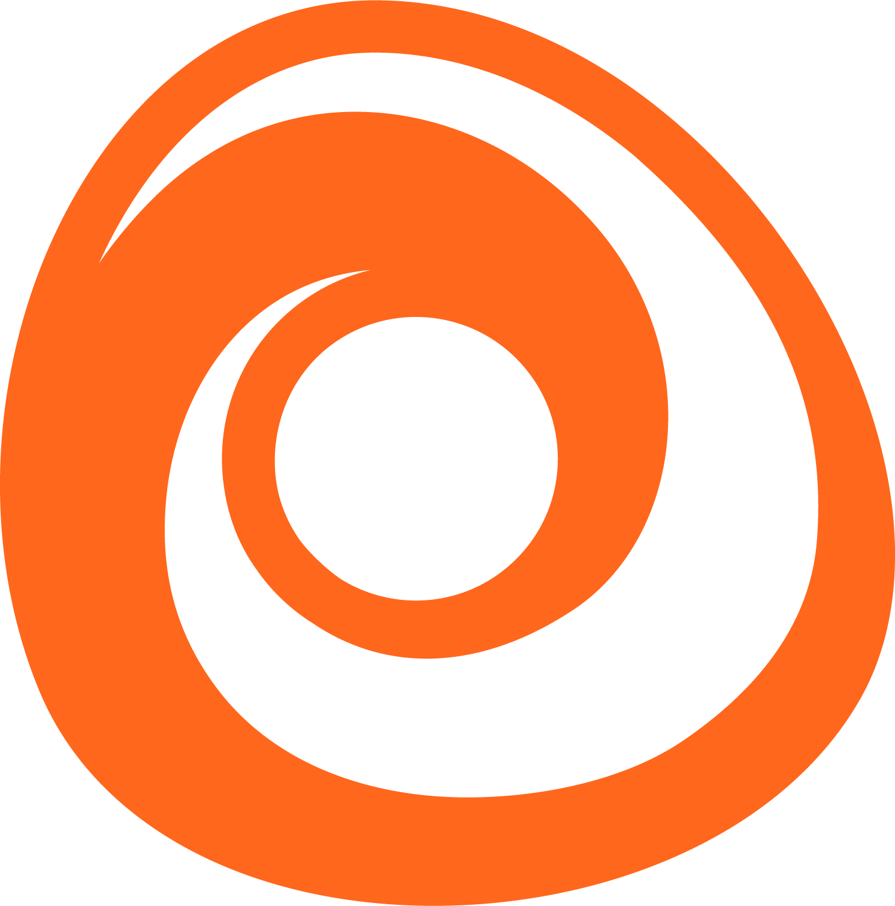
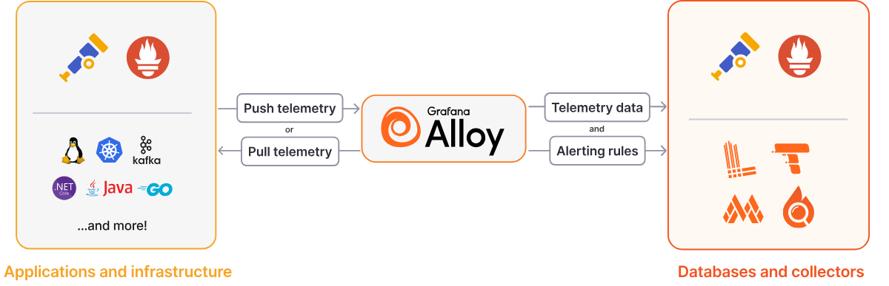
Grafana Alloy
rafana Alloy combines the strengths of the leading collectors into one place. Whether observing applications, infrastructure, or both, Grafana Alloy can collect, process, and export telemetry signals to scale and future-proof your observability approach.
Notes:
Sources:
https://grafana.com/docs/alloy/latest/introduction/
https://grafana.com/docs/alloy/latest/introduction/why-alloy/
Alloy adds built-in Prometheus pipelines and native support for Loki, Pyroscope, and other observability backends.

Slide 31



why Alloy instead of collector
Without Alloy
With Alloy
Separate collection agents may be needed
Different configuration systems
Limited centralized preprocessing
Multiple collection integrations to manage
More operational complexity
One configurable collector for multiple signals
Unified pipeline configuration
Filtering, relabeling, batching, and routing
Prometheus and OpenTelemetry integrations
Potentially simpler agent management
Notes:
Sources:
https://grafana.com/docs/alloy/latest/introduction/
https://grafana.com/docs/alloy/latest/introduction/why-alloy/
Alloy adds built-in Prometheus pipelines and native support for Loki, Pyroscope, and other observability backends.

Slide 32
Live demo:
NGINX Observability
Notes:
Switch to the prepared lab directory. The goal is one Abrak VM in a student sandbox. This presentation does not create cloud resources. Run the lab only using your own authorized account and budget.

Slide 33
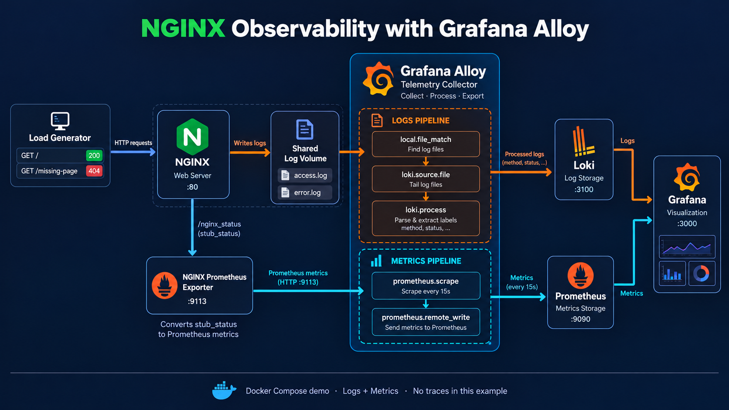
NGINX + Grafana Alloy lab

Slide 34
Grafana Beyla
Grafana Beyla is an open-source eBPF-based auto-instrumentation tool for OpenTelemetry. It provides instant application observability and telemetry collection without requiring any code modifications, language SDKs, or application recompilation.
eBPF Auto-Instrumentation
Zero code changes or manual SDK updates required
Attaches directly to kernel probes via eBPF
Supports Go, C/C++, Java, Python, Node.js, and Rust
OpenTelemetry Native
Exports standard OTLP traces and HTTP/gRPC spans
Captures RED metrics (Rate, Errors, Duration)
Exposes Prometheus metrics endpoint natively
Key Benefits
Instant time-to-value without redeploying apps
Ultra-low CPU & memory performance overhead
Automatic network topology & RED metrics discovery
Notes:
Sources:
https://grafana.com/docs/alloy/latest/introduction/
https://grafana.com/docs/alloy/latest/introduction/why-alloy/
Alloy adds built-in Prometheus pipelines and native support for Loki, Pyroscope, and other observability backends.

Slide 35
Telemetry turns outages into evidence.
Notes:
Close the loop with the opening stories: verify deployment consistency, monitor jobs, test recovery, and review infrastructure changes. Ask students: which guardrail would have caught each failure, and where would you enforce it in the ArvanCloud workflow?

Slide 36


Thank You !!
Let automation handle repetition, so people can focus on better decisions.

